Slide 1
Steel Image Segmentation
Progress Report
Bishal

Slide 2

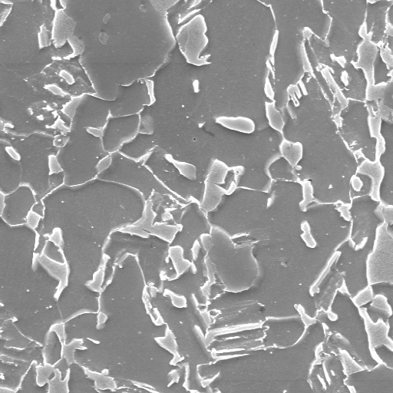
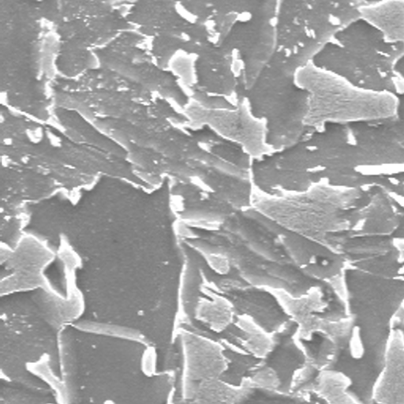
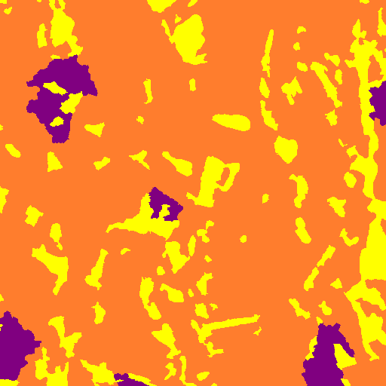
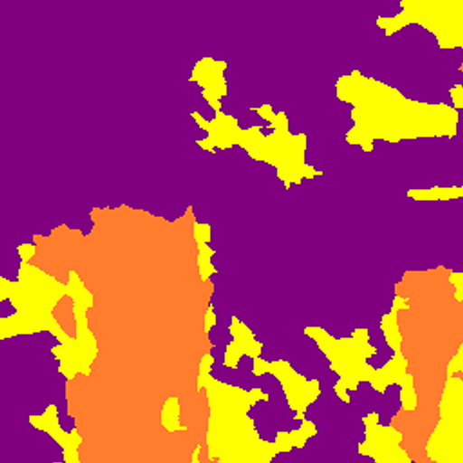
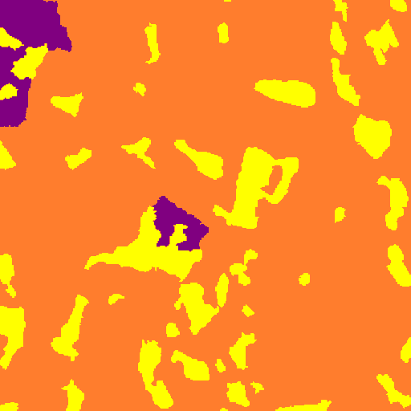

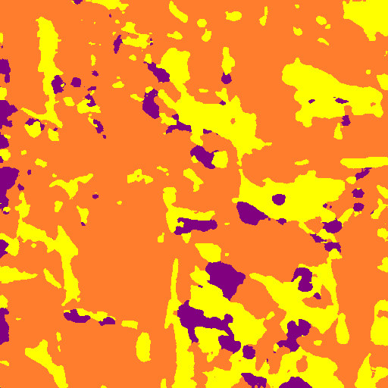
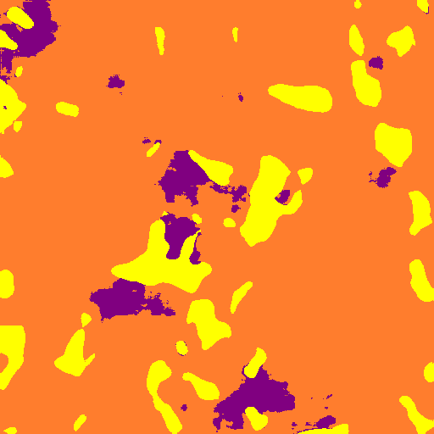
Model Output [Model 7]
Input Test Image
Input Label Image
Output Test Image
Validation mIOU → 0.1734
Validation Acc → 56.87
Test Accuracy → 82.99
Dice Coefficient → 0.81350676 (avg of 48 test images)
Traning mIoU → -
Training Acc → 91.68

Slide 3
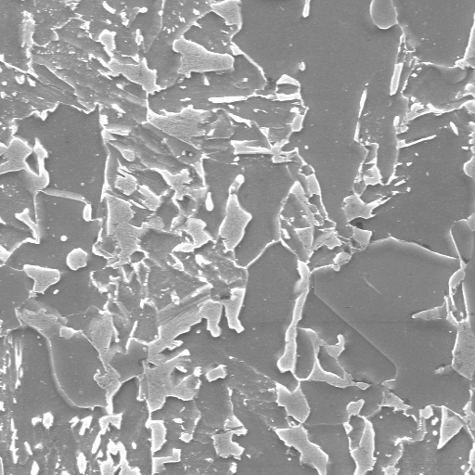
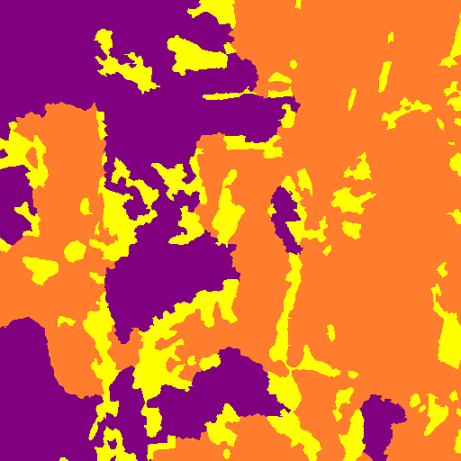
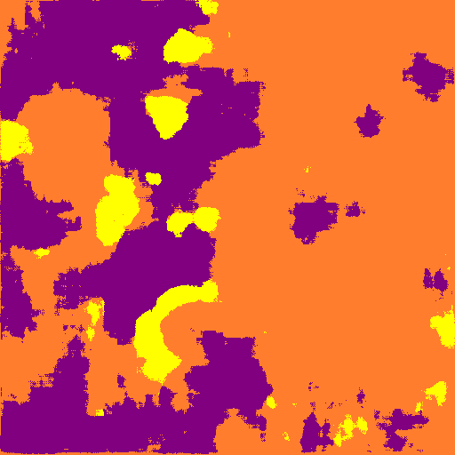
Model Output [Model 8][after 200 iter]
Input Test Image
Input Label Image
Output Test Image
Validation mIOU → 0.3728
Validation Acc → 70.32
Test Accuracy → 61.79
Dice Coefficient → 0.602
Traning mIoU → 0.41621
Training Acc → 78.54

Slide 4
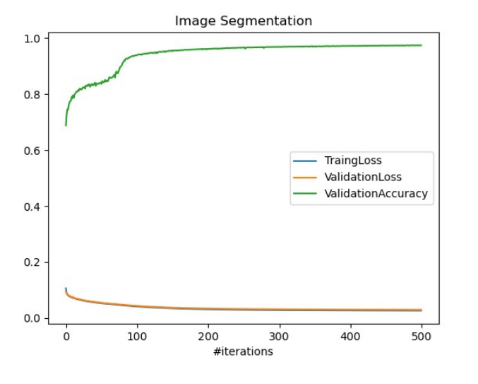
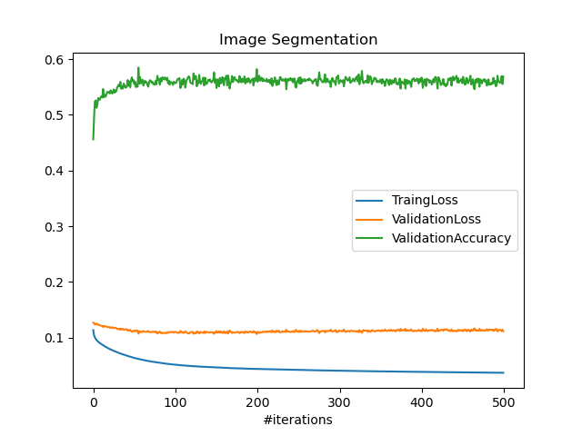
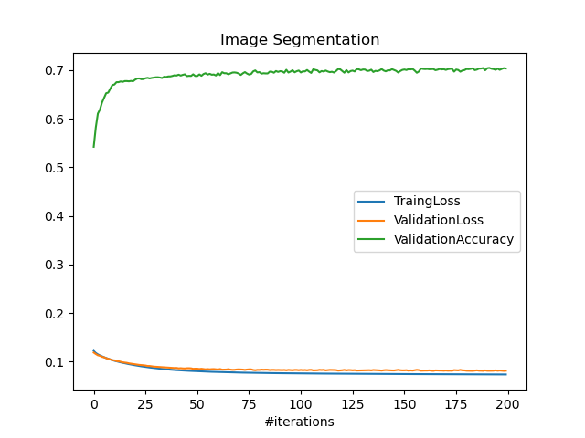
Model Performance
Model 6
Model 7
Model 8

Slide 5
Testing on other type of steel data
Accuracy % on test set
 | 70.01 | 78.75 | 47.71 | 7.46 | 40.48
x3000
x5000
typeA
typeB
typeC
Model 6
58.85
28.82
46.29
73.61
34.48
Model 7
75.81
83.29
74.83
55.9
69.94
Model 8

Slide 6
Model 6, 7, 8
 | Model 6 | Model 7 | Model 8
Augmentation | Zoom Sliding Window | Magnification sliding window random Intensity random gamma rotation up to 10 degrees | Magnification sliding window random Intensity random gamma random noise horizontal and vertical flip rotation up to 20 degrees
Training Image Size | (512x512) | (512x512) | (800, 800)
(Train, Validation, Test) | (5780, 426, 48) | (11724, 213, 48) | (10000, 3000, 920)
Accuracy (#iterations) | 98.91 (500) | 91.68 (500) | 78.54 (200)

Slide 7
Observation
Magnification, sliding window, random Intensity, random gamma, random noise, horizontal and vertical flip, rotation up to 10 degrees were used was using to generate images.
200 iterations took 33 hours.
13920 augmentated images of size 800*800
10000 used for Training, 3000 for validation, 920 for testing

